Slide 1

ACCESSIBLE JOB PLATFORMS

Slide 2

LINKEDIN
LinkedIn is a globally recognized professional networking platform that has become widely used in India for job searching and professional networking. It offers a variety of tools for job seekers, including those with disabilities.

Slide 3
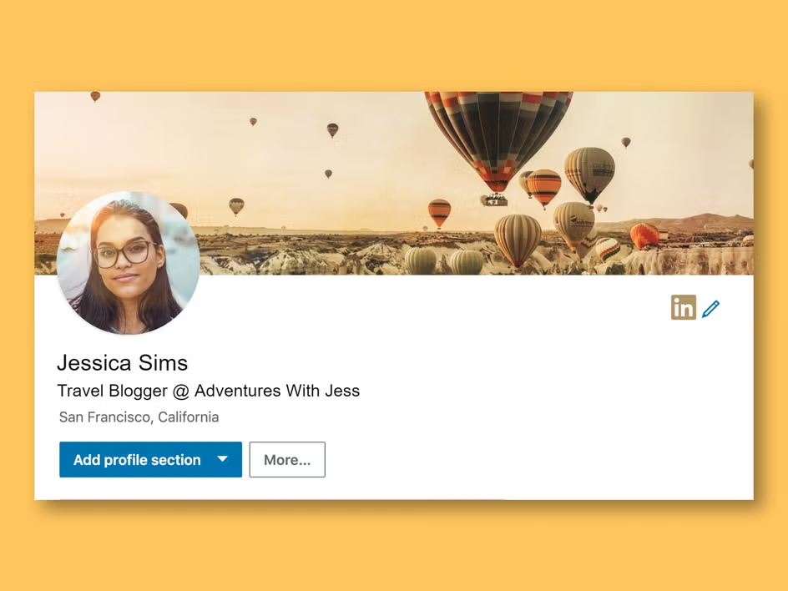
FEATURES
Accessibility Options: LinkedIn is designed to work with screen readers, which helps visually impaired users to navigate their profiles and job listings. LinkedIn also supports keyboard navigation, allowing users to browse without a mouse.
Profile Customization: Users can highlight their skills and experience and include accessibility requirements in their profiles, making it easier for inclusive employers to understand the needs of applicants.

Slide 4
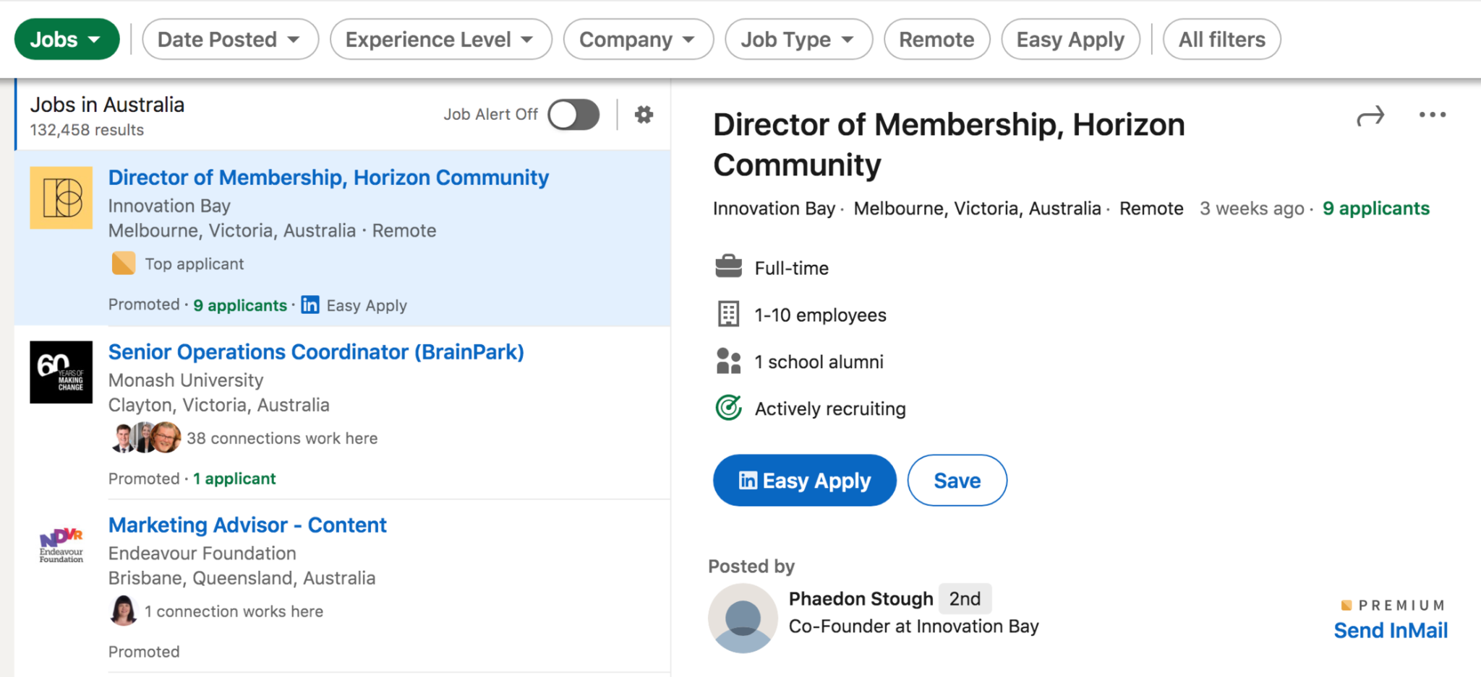
Job Alerts: PWD users can set up job alerts based on specific job criteria and preferences, which can include filters for companies that actively promote inclusive hiring practices.
Networking Opportunities: LinkedIn helps PWD connect with professionals, organizations, and groups that promote disability inclusion in the workforce.

Slide 5
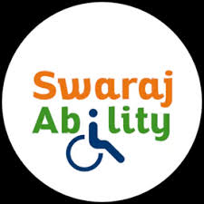
YOUTH4JOBS (SWARAJABILITY)
Youth4Jobs is an Indian social enterprise that helps young people with disabilities find employment, develop skills, and become job-ready. Their platform, Swarajability, is specifically designed to assist PWD in finding employment.

Slide 6
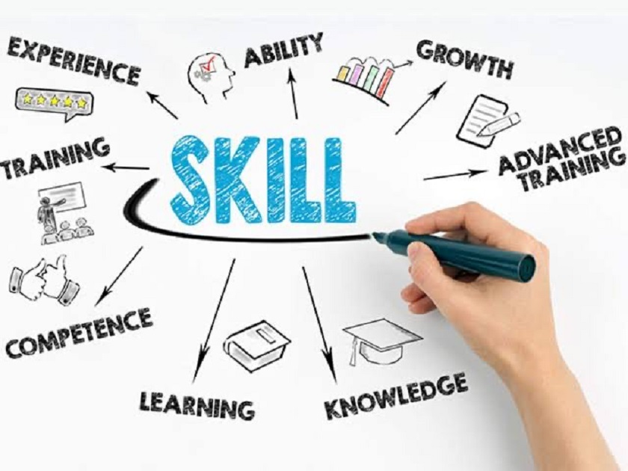
FEATURES
Skill Development: Swarajability offers free online courses and training in various domains, such as IT, customer service, soft skills, and more, specifically for individuals with disabilities. This training helps make PWD job-ready and enhances their chances of finding employment.

Slide 7

Employer Collaboration: Swaraj Ability partners with companies across India that are committed to disability-inclusive hiring, thus increasing opportunities for PWD.
Support Services: Youth4Jobs offers career counseling, resume building, interview preparation, and other support to help PWD navigate the hiring process.
Job Matching: The platform connects PWD with inclusive employers in India, matching their skills and interests with available job opportunities.

Slide 8

Divyangjan Rozgar Setu (PM DAKSH)
The Divyangjan Rozgar Setu is a digital platform developed by the Department of Empowerment of Persons with Disabilities, Ministry of Social Justice and Empowerment. It aggregates job opportunities across India for PwDs, providing geotagged information on employment and earning opportunities within private companies. The platform aims to bridge the employment gap for PwDs by connecting them with suitable job openings.

Slide 9
Telangana PwD Employment Exchange
Established in 2022, the Telangana PwD Employment Exchange focuses on programs for physically handicapped candidates in the state. It provides job listings, training programs, and other resources to enhance employment opportunities for PwDs in Telangana.

Slide 10


